Slide 1
Academic Research Basics
Jeff Werst
WVU Student Success and Instruction Librarian

Slide 2
Reading & Evaluating Sources
Quickly Read a Source
Title and Authors
Abstract
Skim, look for “nontext”
Conclusion
Works Cited
Marks of Quality
Website / Source
Bias, Ads, Sponsors
Proper Formatting
Citations
Notes:
Two of the most important things in doing research are reading and evaluating a source. They are done at the same time, and can be done quickly. In general, when you want to know if a source is reliable and worth using, you need to consider a few things. First and foremost, look at where you found a source. .edu or .gov is the way to go, but outside of that, look for obvious red flags like ads on a page. Academic journals sometimes advertise other journals, that is fine, products is not. A good source, and website, should have good formatting, it’s a basic thing but can tell a lot about a source. Finally, a good source, even if it’s a popular source, should include citations and authority. You need to know who the author is and where they are coming from.
While you need to read entire articles to cite them properly, it can help to do a bit of speed reading, or some basic skimming. First is title and abstract, you can learn at a glance if a source is in your field and worth your time. If it passes that test, then you skim the article itself. Within the article, look for anything different, a break in text. Pictures, block quotes, charts or graphs are all easy ways to tell at a glance if something is important. Finally, look at the conclusion or results to see if it is what you are looking for. If it passes all those tests, then take the time to read the full article so you can cite it properly. While this seems like a lot, once you get used to it, you can do this quickly and easily for any article or source you find. It will save you a lot of time and effort in the long run.

Slide 3
Types of Sources
Peer-Reviewed
An expert submits an article to a journal for publishing.
The journals assigns other specialists in the field to review the article. These peer-reviews examine the article to make sure it is worth publishing based on.
  Was the experiment / research designed and conducted well
  Was the data analyzed correctly
  Were the conclusions reached justified by the data
The reviewers decide whether the articles should be published, not published or resubmitted after revisions.
If the article is published it is considered peer-reviewed / scholarly / academic.
Popular Journal Articles
Articles do not go through peer-review.
Author is hired by the publisher.
Does not perform original research.
May refer to other articles and research but does not necessarily have to cite those articles.
Good for finding key studies, experts, trends, and getting background information on a field.
Notes:
I’m sure you’ve all heard, or even told others, that you have to use “peer-reviewed” or “scholarly” articles as a source. As we can see, a peer-reviewed article is one that covers research or a study in a given field, then reviewed by peers in that field, to make sure everything is on the level, and important enough to be published. If the article is actually accepted by reviewers, and then published in a journal, it is considered “peer-reviewed”, or a scholarly source. These articles have proper citations, usually to other scholarly sources, and are generally suitable for using for your own research. Peer reviewed and scholarly articles are also free of bias, they are focused on facts, data, studies and research. They also will usually have literature reviews or sources that you can use to help guide your own research!
Popular articles on the other hand are not peer-reviewed, but rather editor reviewed. The author, while possibly an expert in the field, and still technically doing research of some kind, isn’t taking part in serious, scholarly research. These articles can reference peer-reviewed articles or studies, and can be useful for helping you find information about a topic, field, or key figures. Time Magazine and National Geographic are good examples of popular sources, they cover a wide range of topics with well written articles, and often reference scholarly sources. Popular sources like those are great for getting background knowledge into a subject. Outside of popular articles, but related to them, you have sources like blogs and Twitter. While these sources might be written by experts, they are not scholarly or peer-reviewed. They can provide background to a topic, but sometimes are an outlet for an author’s biases. It’s worth noting though, that in some instances, you won’t be able to find scholarly sources, just popular ones, such as for current events. In that instance, you want to cite the most official source you can, for example a government press release is better than the New York Times for recent government events.

Slide 4
STEM Writing vs Humanities
STEM Research
Research is considered separate from writing, or more so, writing is a secondary step
Focus is on “practical work”, such as experiments and calculations
Usually structured: Introduction > Methods > Results > Discussion
Shorter, more clear and concise articles; quantitative
Articles preferred over books
Passive tense, focus on results instead of people
More collaboration, shorter peer review / faster publication turn around time
Readers often want data more than words
Humanities Research
Writing is a core part of research, it’s the end product in most cases
Focus is on generation of ideas, furthering of the scholarly conversation
Less structured, dependent on the content
Longer articles, more qualitative
Articles are often just excerpts of books
Focus on larger picture, rather than individual results
Longer peer review, often solo authored
Readers want to see a narrative that can tie to their own research
Notes:
While all academic fields do research and writing, there are some core differences between STEM and others, such as the humanities or social sciences. For STEM, writing is often the dreaded secondary step in the research process. They are more focused on practical work like experiments, even in the writing itself. They have more rigid structural requirements, because their articles tend to be shorter and more concise, with a focus on quantitative information. By in large, STEM is focused on articles rather than book publications. Those articles are written in passive tense, and focus on results instead of the teams behind them. The research and writing process is often more collaborative, large teams will co-author a single paper. There is a shorter publication turnaround time and faster peer review process, as other researchers can be demanding to see those results and data.
In the humanities, and in some social sciences, writing is the core part of the research, and often the end goal. The focus isn’t on data, so much as the generation of ideas and entry into the larger academic or scholarly conversation. If they are structured, it’s more so based on content, rather than field. While articles are still common, they are often just excerpts from books or spun off from a presentation or thesis. This research is focused more on the larger picture, rather than individual results. There is usually a longer publication and peer review process, in part because the articles themselves are much longer and more qualitative. Readers are more focused on the narrative aspect and that big picture, rather than raw data. Some social sciences, depending on how research heavy they are, take elements of both sides for their writing process.

Slide 5
Research into Writing
Paraphrase
Putting someone else’s words, thoughts or ideas into your own words.
Restructured and rephrased, but similar in length to the original.
Summary
Putting someone else’s words, thoughts or ideas into your own words.
Restructured and rephrased to be shorter.
Direct Quote
Word for word restating something, without any changes.
Put in quotation marks!
Patchwriting = Plagiarism
Copying from a source, changing some text slightly.
IE: Altering grammar, using synonyms.
DO NOT DO THIS.
Notes:
Obviously, the best way to avoid intentional plagiarism and academic dishonesty is just to not do it. Don’t cheat, and try to cite your sources properly. Which means the bigger question is how to cite, and avoid unintentional plagiarism. One of the biggest issues I have seen students face, is how to talk about sources they are citing or using. You have a couple of options here.
You can paraphrase or summarize. These are very similar, but with a key difference. Both restructure and rephrase something, but with a paraphrase it is of similar length to the original, while summary is a lot shorter. Either way, you need to include a proper citation to go with it, as you are still restating the idea of different source. Most of your research writing should be done these ways. It shows you have a good grasp of a source or concept, and it’s easy to weave your own voice into it then. You could alternatively use a direct quote. That is when you word for word copy something, but have it in quotes with a proper citation. This is ideally used for concepts that are hard to restate or understand, or if you are analyzing specific sections of a text.
Last, and absolutely least, is patchwriting. This is when you copy from a source and then change the text slightly. Rather than a full rephrase like paraphrasing or summarizing, patchwriting is just swapping of key words or inverting sentence structure. So if your original source said “Bill is talking to Sally and Matt”, you say “Matt and Sally spoke to Bill”. It’s the same thing, just changed to quickly pass the sight test for copying. Proper citations don’t make patchwriting better either. Again, because you want to be able to show you understand a concept and can put in context, rather than just use a thesaurus.

Slide 6
What is Plagiarism?
Plagiarism:
Presenting another’s work as your own, whether intentionally or unintentionally.
Example: Copying content from another without proper citation or context.
Academic Dishonesty
Using unethical means to achieve success in an academic environment.
Can include plagiarism!
Example: Cheating on an exam.
Why do students plagiarize?
Struggle with a concept or assignment
Don’t know how to cite
Ran out of time to complete assignment
Potential Penalties
Lower grade or failure.
Academic probation, suspension, or dismissal.
Loss of scholarships or other program participation rights.
Notes:
Today, I want to talk to you briefly about plagiarism, and how you can avoid it in the course of your academic careers. As we can see, plagiarism is defined as presenting someone else’s work as your own. It doesn’t matter if you did it on purpose or accidentally, it’s still plagiarism. Closely tied to plagiarism is academic dishonesty. As the name implies, most people know this as cheating, but plagiarism also falls under this category, because it’s an unethical way to achieve success. There’s many reasons people cheat or plagiarize, and again, it’s not always intentional. Sometimes you might struggle with a concept and misrepresent it. Others, it could be an assignment you don’t understand and do wrong. Sometimes, it’s simply because you ran out of time to complete an assignment and rushed to put something out. Of course, there are penalties for plagiarism or academic dishonesty, which is why we want to understand them. No one wants to risk a lower grade, failing a class, or even worse, being expelled or losing a scholarship because they were accused of plagiarism.

Slide 7
Summary vs Synthesis
Summary
What is the most important information in a source?
Paraphrase, do not copy and paste.
Synthesis
How do the sources relate to one another?
How do the sources relate to your work and research?
Form a narrative.
Notes:
Anytime you are talking about a source, you need to consider if you are going to summarize or synthesize. Sometime these points are combined, but they are two very different things. You can think of the summary as the box score of research, while the synthesis is the play by play.
You'll be summing up your findings as you research and as you write. Figure out what the most important piece of information in a given source is when you find it, and also what the summary of each paragraph you are writing is. Think of it like creating a "too long, didn't read" for your findings. While this is an important piece, it's not as critical as the synthesis.
The synthesis is how the sources relate to one another, and to your own research. This is where the actual analysis happens, and you create your own narrative. You need to cover the importance not only of the sources you found, but how it relates to the research you are doing. This is where your own voice comes into play, where as the summary is more paraphrasing.

Slide 8
Conduct a Literature Review!
Steps of a Lit Review:
Clarify your topic or scope
Find Models / Examples
Find and Evaluate Sources
Organize your work
Write!
Revise
Consider the following for scope:
How many sources?
What types of sources?
Orientation toward sources (summary/synthesis/evaluation)
Background information
Parameters of sources (time, geography, method, language, discipline, etc.)
Diversity of sources
Notes:
One thing you might be told to do, or might want to do on your own, is to conduct a literature review. A literature review is a way to see what research has already been done in a topic or field. Most serious academic search include a literature review, because it shows you have done the work to understand where your research fits in with the larger field. If you have a research theory or topic, and aren’t finding literature on it, it could be a sign that either you need to revise your theory, or get help with your research. First and foremost, you want to think about your topic or scope with a lit review. How many sources do you need, what types of sources? Do you need to get into synthesis, summary, or evaluation? Do you need background information before you start, or in some cases, do your readers need any? Consider the parameters of sources, time especially. Finally, think about having a diversity of sources, don’t cite the same authors or publications over and over.
With your scope defined, you can start finding models and examples, then actual sources. You’ll want to evaluate anything you find, which we talked about earlier. Once you’ve done that, you can organize your work, and then start writing and revising your review. Don’t be afraid to go back to earlier steps if you are having issues too.

Slide 9
Topic > Research Question
Batteries
Start with a broad topic, then hone it down bit by bit until it's a manageably-sized scope for your assignment.
EV Batteries
Next, formulate it as a researchable question.
Materials
Etc.
What materials can be used in electric vehicle batteries to achieve greater durability?
Notes:
Anytime you are doing research, it can help to turn your topic into a research question. This helps you narrow down your focus and results, and also gives you other elements that you can pull from when you are doing searching. For example, you wouldn’t want to just go to Google Scholar and type in “batteries”. You can limit your results some if you want to look at electric car batteries maybe. But let’s go further, and think about the materials those batteries are made of. Finally, why does that matter, what are you actually looking for? That’s your actual research question. But you can take steps back and search for those individual elements still too. Maybe a focus on said materials, or just more information about electric cars. By having a research question, rather than just a topic, you can make your research easier.

Slide 10

KEYWORD SEARCHING
What is this image?
Coca-Cola
Soda
Pop
Soft drink
Can of Coke
Carbonated beverage
None of the above are incorrect, but you'll get very different search results with each of them. Experiment with related terms and synonyms, and try to predict which terms will be most effective in a specific context.
Image from: https://www.flickr.com/photos/allencheng/264714352
Notes:
One important aspect of searching is using the right keywords. With this example, what is this a picture of? There’s lots of different options, and none of them are wrong, but each one will yield different search results. Don’t be afraid to try different terms for the same thing when you are searching, you might be missing out on that perfect fit article if you decide to call this soda instead of pop. While this example focuses on something relatively simple, it works for every field and area of study. If you are researching in STEM for example, consider both common and scientific names of things to make sure you are seeing all the results.

Slide 11
Database Search Strategies: Basic tips
1
2
3
Isolate main concepts
Develop a list of synonyms / related terms
Use one source to find others
Notes:
For any searching you do, there’s some basic tips you can use. First and foremost, you need to isolate the main concepts of what you are looking for or need to find information for. This can be as simple as having a single word to go on, but sometimes having a full research question ready to go can work. If you have a full question, you’ll want to think about the different elements of it.
Next up, you want to think of synonyms or related terms for the words and ideas you isolated first. You will be using all of these in your search, if only to make sure you aren’t missing out on potential results. Finally, you can use one good source to find another. Think of it like recommendations on Amazon or Netflix, their creepy algorithm can tell you what others have bought or watched that’s related, and searching can do the same thing. You can use an articles works’ cited page to find similar results, some databases will link to related things, and some datasets can link to articles written using them, or even other related sets.

Slide 12
Finding Sources in Databases
The following databases may be useful to you as you progress through the semester:
Google Scholar
Academic Search Complete / Ebscohost
Scopus
You can find links and more information on them here:
https://libguides.wvu.edu/
Notes:
https://libguides.wvu.edu/ENGL_103_20

Slide 13
Cite Your Work
Citation Styles
Different fields use different styles
Different professors might want different styles
Each style is slightly different
There are different ways to cite every possible source
Consult style guides
When in doubt, ask your professor or a librarians!
Citation Managers
Integrate into documents
Pull citations from official sources
Accept different styles
Save time and effort
Better than copy and pasting
Notes:
Last but not least, you of course need to actually properly cite your sources. If you don’t, even if you’ve done the research correctly, you can be guilty of unintentional plagiarism. There’s a few ways to go about this. First, you need to understand citation styles. Different academic fields use different citation styles for various reasons. Sometimes, different professors will use different styles from the norm, and even for different assignments. While using the wrong style isn’t plagiarism, you could be docked points for not following directions. Every style has its own style guide, and these can be found online. They go into how to cite each potential type of source within that style. If you are doing old fashioned citations, hand creating them, you will refer to these a lot.
Alternatively, you can use a citation manager. These are different from citation generators like EasyBib or Citation Machine. Managers will keep track of all your sources, sometimes even with PDFs of articles, and allow you to input citations, pulled from those sources, in any style you choose. Some of them cost money, but one I will talk about today is free and easy to use. They save a ton of time and effort in your research, and obviously more importantly, ensure you are using proper citations and not plagiarizing.

Slide 14
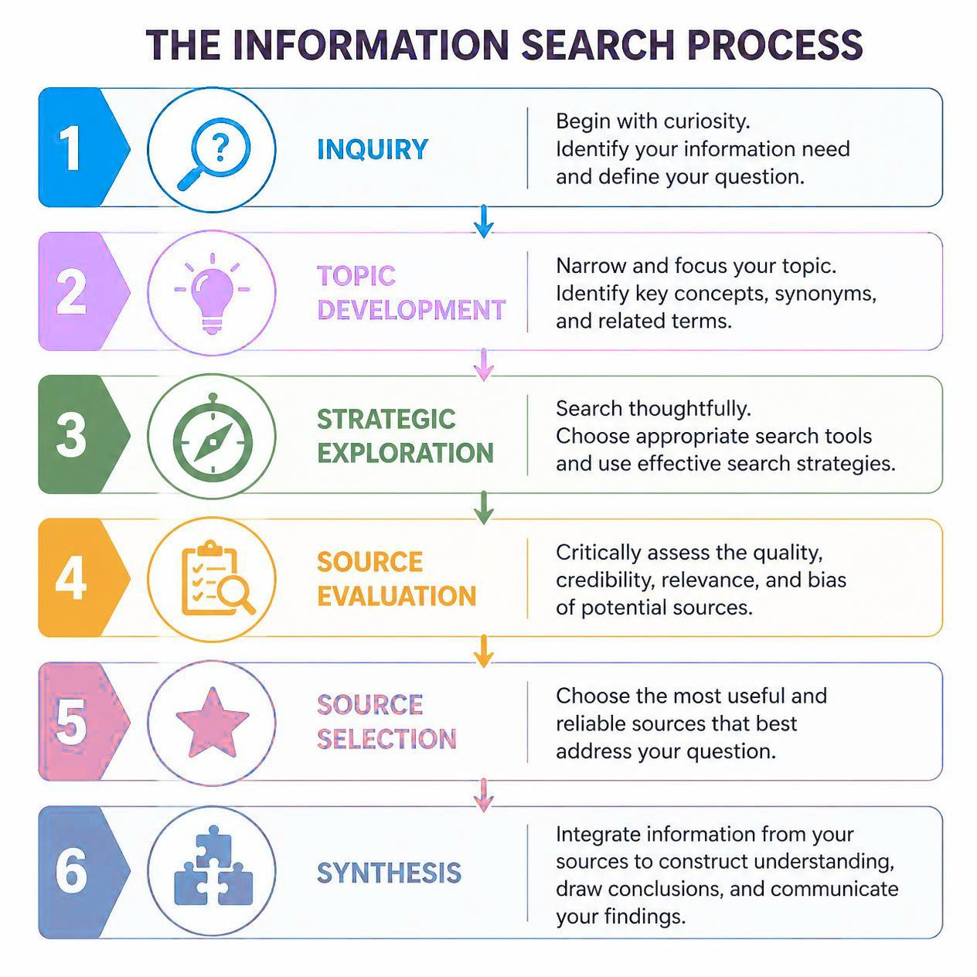
Ai, Research Processes, & Information ecosystems
Generative AI is changing how information is:
  Created
  Discovered
  Communicated
  Evaluated and Perceived
Notes:
Generative AI is likely the type of AI you are most familiar with or most associate with AI in the classroom at least. Generative AI refers to systems that create (or generate) something – be it an image, a video, or even text like an essay – based on a prompt given to it by a user. Generative AI tools have exploded into the public eye recently as they’ve become more accessible, with many being offered free for users.

Slide 15
MYTH | REALITY
AI is replacing researchers. | AI automates tasks, not scholarly communication or judgment.
AI knows everything. | AI tools like ChatGPT predict language and may be confidently wrong. Also prone to bias and hallucination.
AI detectors are reliable. | Detection tools have significant limitations. and often misidentify submitted work

Slide 16
STEP | AI CAN... | Human responsibility
Brainstorming | Generate Ideas | Ensuring suggestions meet research or assignment needs, have an appropriate scope, does not merely recylce existing research or ideas
Information Searching | Suggest Search Strategies | Ensuring the suggestions are relevant, are appropriately broad or narrow depending on needs, suggest strategies that are possible with where you are searching
Reading & Synthesizing Sources | Summarize Sources | Ensuring the AI Output Is accurate, free of bias or hallucinations, and logically links sources
Writing | Draft, Organize | Ensuring appropriate scope, formatting, Information, and citation. Consider if output may contain copyrighted material or IP not appropriate for your own use
Editing | Structure or Grammar Suggestions | Ensuring suggestions are accurate, follow writing conventions, and are logical
Publishing & Research Impact | Journal Recommendations | Ensuring the suggested publications actually exist and, if so, are relevant to your field or the subject your are researching

Slide 17
Early in the process | In the research stage | Further in the process
Generating ideas | Finding sources – using tools that summarize | Critical Thinking – ask a good question
Narrowing the scope of a topic | Finding connections – tools that harness data | Feedback – Avoid ChatGPT for this (or really any large LLM)
 | Formatting References – Citation Managers | When you are stuck on transitions, headers, titles
 | Outlines – to organize thoughts and research | Cite your AI use

Slide 18
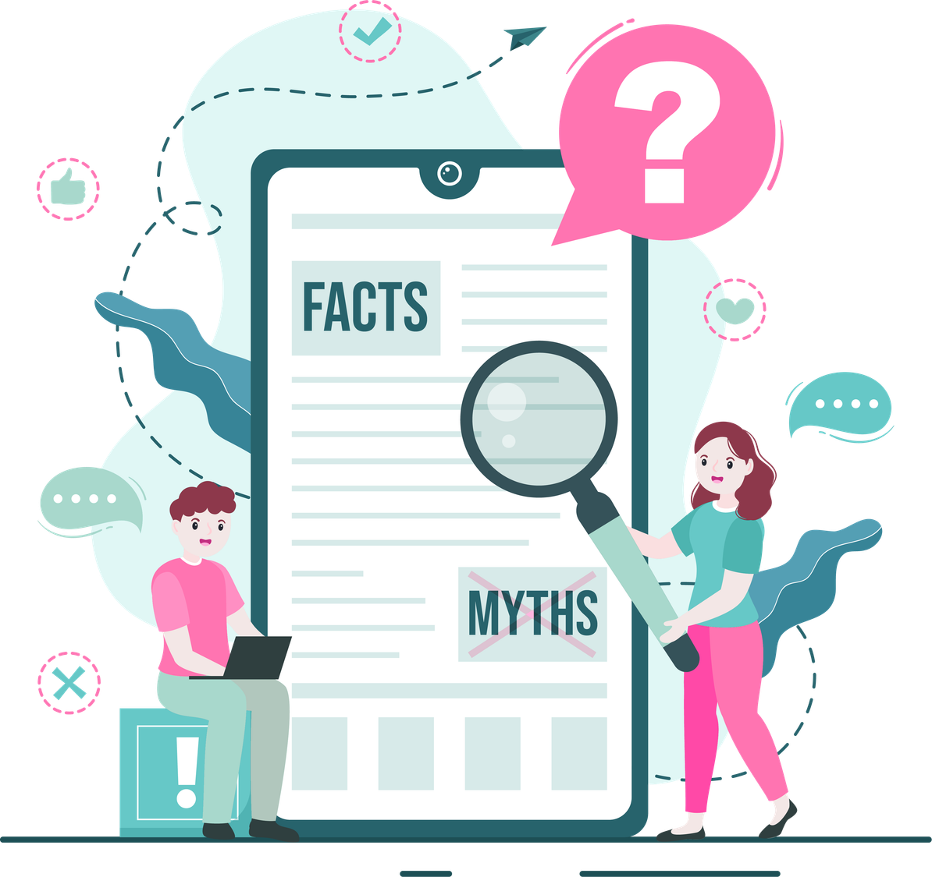
How can I use AI responsibly?
  Weigh the pros and cons to determine if AI is the best choice for a task
  Determine if output is missing context or displays evidence of bias. Is anyone or anything missing from consideration?
  Fact-check output and apply human judgment
  If sources are given or cited, do these exist? Is all of the information correct?
  Is anything included or drawn from that may be copyrighted or put someone else’s IP at risk?
  Are you considering the privacy implications and your own IP? Or the IP of anything you may be inputting into the AI tool?
Notes:
Generative AI is likely the type of AI you are most familiar with or most associate with AI in the classroom at least. Generative AI refers to systems that create (or generate) something – be it an image, a video, or even text like an essay – based on a prompt given to it by a user. Generative AI tools have exploded into the public eye recently as they’ve become more accessible, with many being offered free for users.

Slide 19
AI Warnings and Considerations
If you use AI, use it as a tool, DO NOT use it to replace yourself in creative or critical thinking, let it assist, not do all the work
AI usage should be disclosed and cited
AI results can be biased, their algorithms are often unclear to us
Not all tools are created equal, and paywalls exist in tools as well
AI tools can’t bypass paywalls, ie: they can’t get articles in databases
Be aware of any assignment, university, funder, copyright, or ethical considerations regarding AI
AI will take whatever you give it to use in its own learning; it can and will steal your ideas and inputs, which is a major privacy and copyright concern
AI “art” is based on theft, and absolutely harmful to artists and creatives
AI tools use a lot of energy and resources, there are major environmental concerns
Notes:
For any searching you do, there’s some basic tips you can use. First and foremost, is what we did first, isolate the main concepts you are interested in or need to cover. So that is making your research question, and picking out specific terms or ideas. Next up, you want to think of synonyms or related terms for the words and ideas you isolated first. You will be using all of these in your search, if only to make sure you aren’t missing out on potential results. Finally, you can use one good source to find another. Think of it like recommendations on Amazon or Netflix, their creepy algorithm can tell you what others have bought or watched that’s related, and searching can do the same thing.

Slide 20
Help and Resources
https://westvirginia.libanswers.com/
https://libguides.wvu.edu/LitReview/Home
https://libguides.wvu.edu/Citation_Guides
https://libguides.wvu.edu/citation_managers
Notes:
Now that we’ve discussed some of the basics, I’d like to take some time to show you some of the libraries’ resources that you can use to conduct your research, and better cite your sources once you find them

